Slide 1
4-H Show Cattle Facilities
Sam Womble
County Extension Agent
Bexar County

Slide 2
First Things First
What are the basic needs of my show cattle project?
Space
400 sq. ft. minimum (stall)
Nutrition
fresh feed and water
Shelter
protection from extreme weather conditions

Slide 3
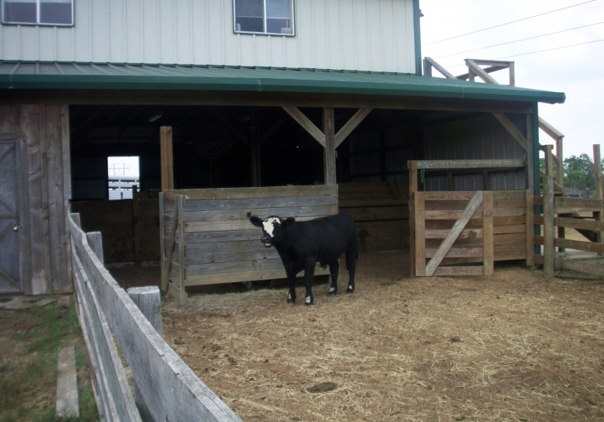
Facilities
Be a good neighbor
Check deed restrictions and zoning laws before you begin construction
Plan ahead
Can you utilize an existing structure?
Consider costs
Functional, not necessarily elaborate

Slide 4
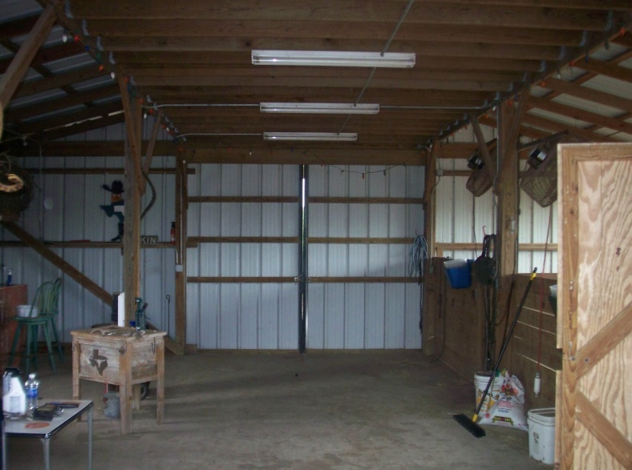
Facilities
Electricity
Outlets need to be in a safe location
Ceiling height/ventilation
Temperature
Flooring
Be cautious of slick surfaces
Sand or shavings work well
Tie area
Helps cattle stand correctly
Storage
Feed, equipment, supplies

Slide 5
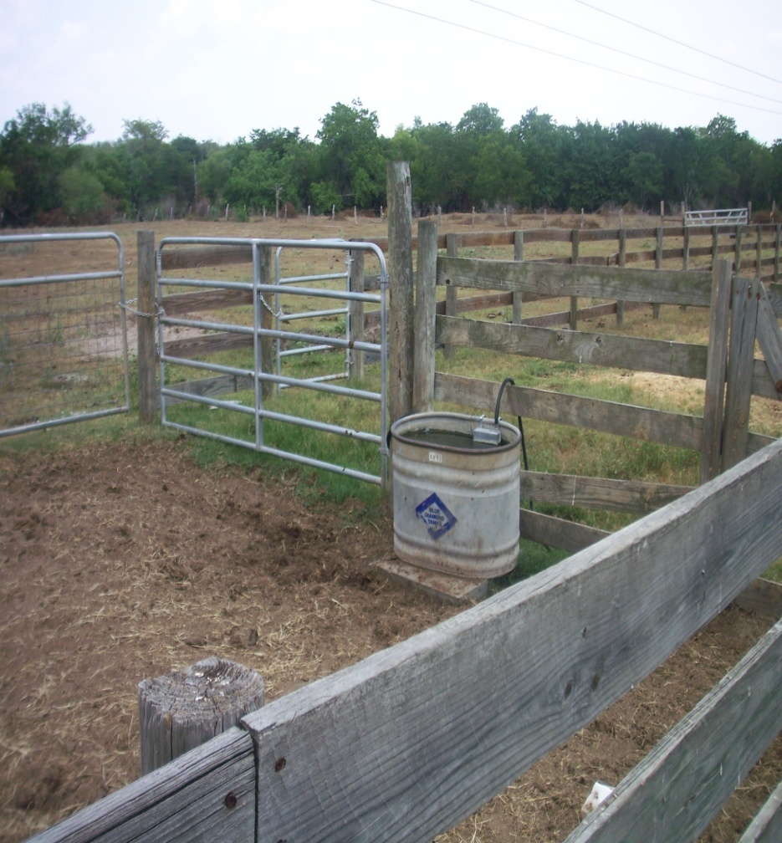
Facilities

Slide 6
Geographic Location
South Texas
Cold
cattle prefer temperatures between 41 and 77 degrees
north wind break
dry
Heat
utilize shade, fans, misters, and prevailing wind

Slide 7
Soil Type and Drainage
Soil type
High sand content as opposed to a clay soil
Drainage
Slope
1ft. slope/100 ft.
Base material to build up elevation

Slide 8
Accessibility
Walking distance of your house
Convenience
spend more time at the barn
enjoyed more by family, youth, and friends
Trailer access for loading/unloading
Pen accessibility with fresh cattle
All weather road

Slide 9
Cleanliness
Pens should be cleaned twice daily
Aid in controlling insects, disease, and odor
Optimize cattle performance
Disposal
Carry waste away from pens
Compost pile

Slide 10
Conclusion
Facilities play a key role in show cattle performance
Be mindful of safety considerations
Keep facilities clean and sanitary

