Slide 1

Wildlife Module Curriculum Enrichment Program
Bexar County 4-H Youth Development
Mike Shockey
Youth Outreach Educator

Slide 2
Relevance
As society becomes more urbanized generations posses little or no understanding of links between natural resources management and quality of life.
  80% of Texas population lives in urban areas.
  Remaining 20% control 80% of land and live in rural areas.
Many youth, especially minorities, have little direct contact with wildlife in their natural habitats.

Slide 3
Response
A concerted effort was needed to expose youth to learning opportunities related to wildlife conservation and management, water quality, aquatic science, species & habitat protection and their associated ecosystems.
Modules developed targeting elementary & middle school students with hands-on displays, interactive computer programs, videos, lesson plans and testing materials.

Slide 4
Response
Modules are available for use by public and private schools, community centers and collaborative partners for a two-week period throughout the year.
  Host educators request materials and are instructors for the curriculum.
Students are pre-tested before use of curriculum and then post-tested after modules two-week stay on site.
  A minimum of one class required to complete testing materials
  Internal evaluation made comparing test scores between testing periods.

Slide 5
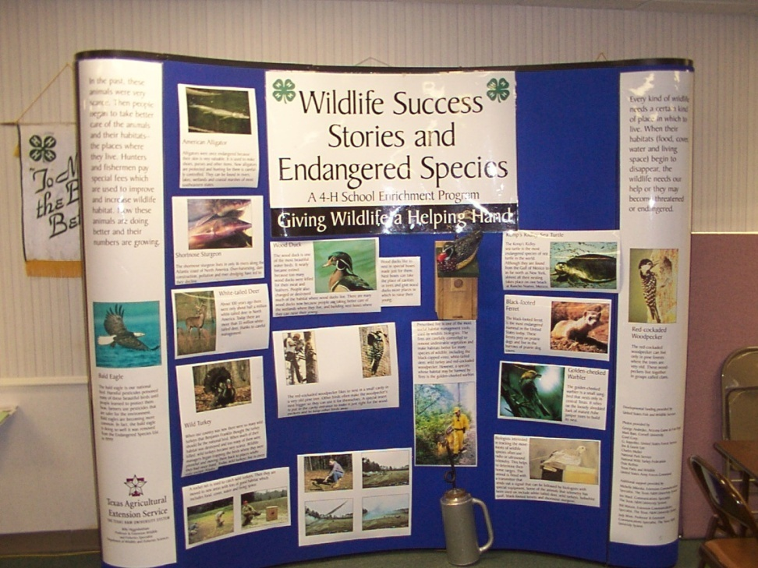
Wildlife Success & Endangered Species
3rd Grade Level
Targets Science, Math and English
8’ x 8’ Pop-up display
Interactive CD & video
Teacher Binder
10-question Pre and Post Test

Slide 6
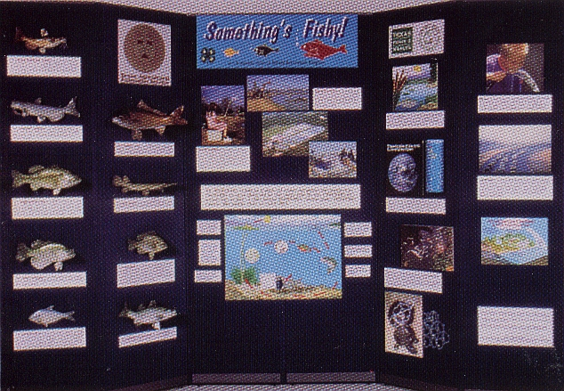
Something’s Fishy
Targets 4th Grade
Teaches aquatic science and water conservation
3’ x 8’ 3-D Display Board w/full-size fish replicas
Interactive CD + videos
Teacher Resource Binder
15-question Pre and Post Test

Slide 7

City Critters
5th Grade Unit
Emphasis on math, science, reading
8’ x 10’ Pop-up Display
Interactive CD + (6) videos & booklets
Teacher Resource Binder
15-question Pre and Post Test

Slide 8





Predators in the Classroom
Grades 4-7 Curriculum
Emphasis on critical thinking skills
(1) large laminated poster
Interactive CD + video
Teacher Resource Binder
10-question Pre and Post Test

Slide 9
Program Results
A total of 2,073 youth at 32 different campuses participated in the Environmental Education & Earth Sciences Wildlife Module Curriculum Enrichment Program.
Testing results showed an increase of 24%-33% in knowledge of wildlife conservation & protection practices after module use.
Estimated cumulative economic impact of the four wildlife modules to the participating campuses was put at $26,818.

Slide 10
Request Form
Educators may inquire as to the availability of any/all of the Wildlife Modules by completing the Response Form shown on the next slide.
  Print and Complete Form
  Submit via mail, fax or scan and attach to email
  Contact will be made via telephone/email as soon as possible upon receipt by Outreach Program Staff

Slide 12

Questions??
Contact: Mike Shockey
Youth Outreach Educator
Bexar County
Ph: 210.467.6575 ext 225
email: meshockey@ag.tamu.edu

